Slide 2
Presentation
Introduction
DofE & Expedition Section
Preparing for Expedition
Online Training
Q&A
Presented by:
Matt & Claire
Operations Managers
Notes:
Matt

Slide 3
Karos Adventure
Company started 2016
Based in Uttoxeter; roots are in Nottingham
Steve Wilkins - Managing Director - Bronze, Silver & Gold Award holder
40 years involvement in running DofE
Support 25 schools & 1500+ participants
Notes:
Matt

Slide 4
Safety
AALA & DofE Licences
Public Liability Insurance
Risk Assessments
Incident Reporting
Emergency Procedures
Notes:
Matt

Slide 5
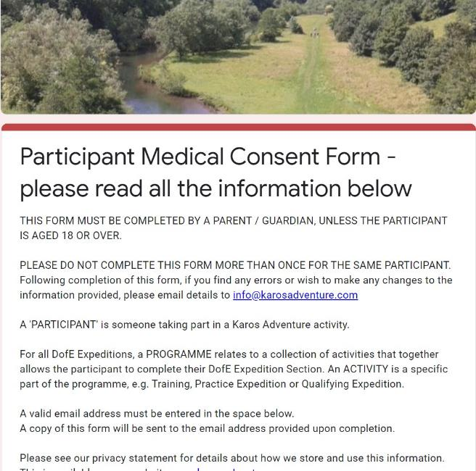
Medical Consent Form
Complete ASAP by parent or guardian
Full and honest disclosure
Complete once - updates via email
Compliant with GDPR
Information made available to leaders
Notes:
Matt

Slide 6
Our Leaders
NGB Walking and Canoeing qualifications
16-hour Remote First Aid
DofE Accredited Assessor
Enhanced DBS checks on Update Service
Regular Safeguarding training & CPD
Many years of experience
Expeditions UK & abroad
Notes:
Matt

Slide 7
DofE Bronze Award
 | Volunteering | 6 months in one section + 3 months in the other 2 sections Average of 1 hour per week in each section
 | Skills
 | Physical
 | Expedition | Training - 2 days, 1 night Qualifying - 2 days, 1 night
Notes:
Claire

Slide 8
Expedition - What is it?
Unaccompanied journey
Teams: 4 - 7 participants
Fully trained
Team Goal
Self-sufficient - carry everything within team
No motorised transport
6 hours of planned activity per day
Respect each other, the public & the environment
Notes:
Claire

Slide 9
Residential Training
2 Days with Overnight Camp
Day 1
Campcraft & equipment
Accompanied navigation training walk
Teamwork
First aid & emergency procedures
Awareness of risk
Observation & recording
Countryside Code
Proficiency in mode of travel
Qualifying route planning
Cooking & food
Notes:
Claire

Slide 10
Residential Training
Day 2
Cook & eat breakfast and break camp
Remotely supervised training walk
Putting into practice skills learnt
Debrief and review
Notes:
Claire

Slide 11
Bronze Qualifying Expedition
2 Days with Overnight Camp
Each day teams complete a remotely supervised, self-sufficient journey
6 hours Planned Activity per day
Overnight camp
Cook & eat a substantial meal each day
Debrief with Assessor
Comply with Expedition Requirements
Notes:
Claire

Slide 12
Supervision
Karos Leaders
On site throughout all programme dates
Responsible for all expedition-related activity
School staff
On site throughout all programme dates
Responsible for all pastoral matters including overnight supervision
Notes:
Claire

Slide 13
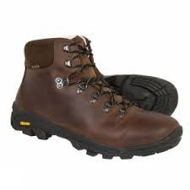
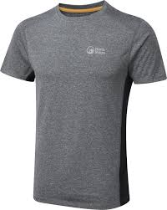
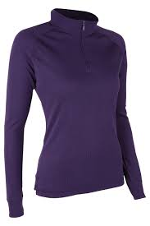
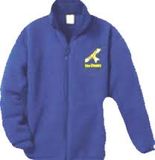
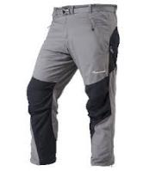
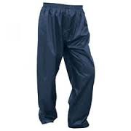
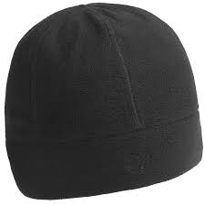
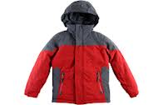
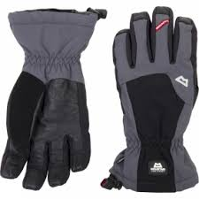
Equipment & Clothing
Walking Boots
Must have ankle support
Leather or fabric
Clothing
Synthetic fabrics
Multiple thin layers
NO jeans
One spare set
Waterproofs
Jacket
Overtrousers
Taped seams
Hat & Gloves
Sun Protection
Notes:
Matt

Slide 14
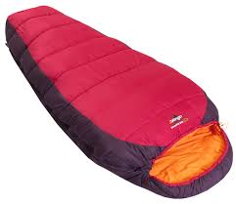
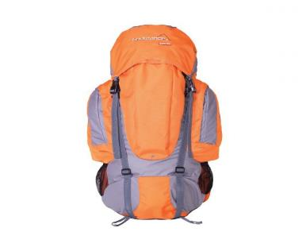
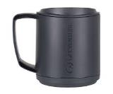
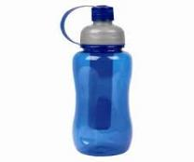
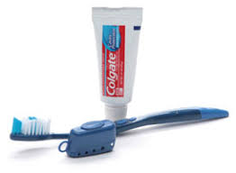
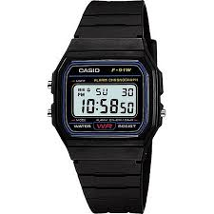
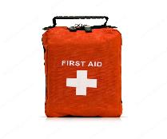
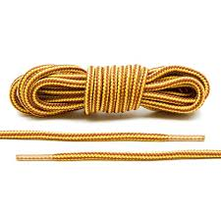
Equipment & Clothing
Rucksack
55-65 litre capacity
Sleeping bag & roll mat
2-3 season
Thick rubble sack
Torch, personal first aid kit, medication, watch, water, spare laces/cord
Essential items only
Pack small
SPARE
Notes:
Matt

Slide 15
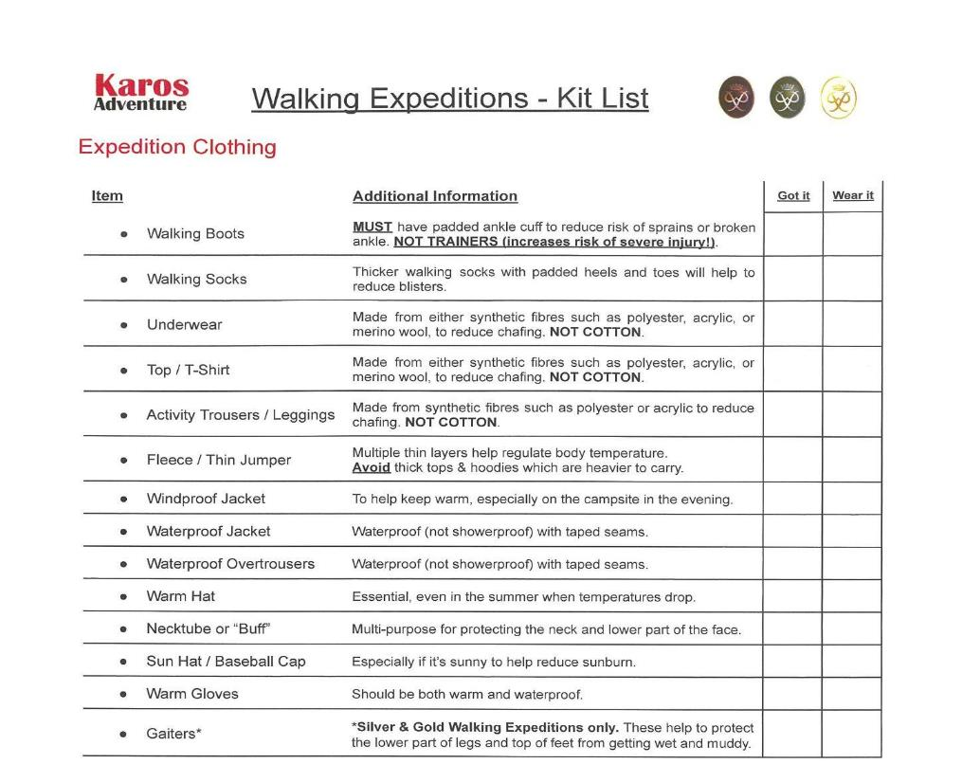
Karos Adventure Kit List
Download from website
Part of Joining Instructions
Borrow kit where possible
Notes:
Matt

Slide 16
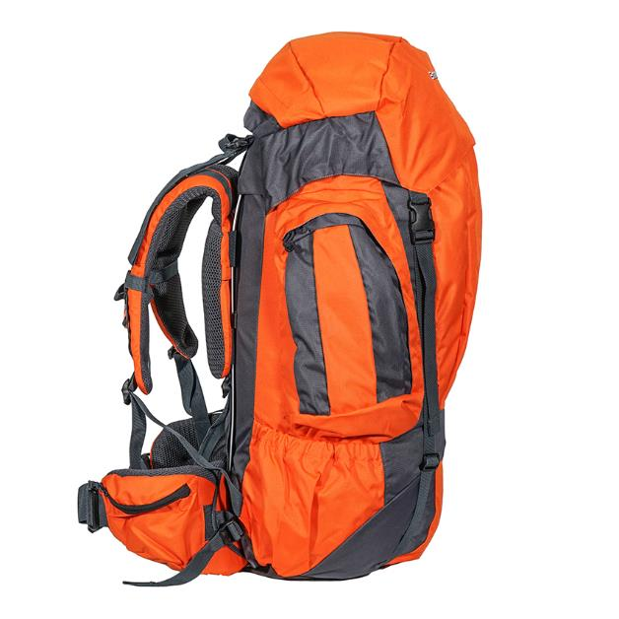
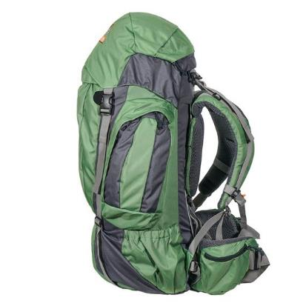
Rucksacks for Hire
Standard 65 litre rucksack or
“Slimjim” 65 litre with smaller back system
Limited supply available on “first come, first served” basis
£10.00 + VAT for programme
Ordered via school
Delivered to start
Collected at finish
Standard 65 litre
“Slimjim” 65 litre
Notes:
Matt

Slide 17
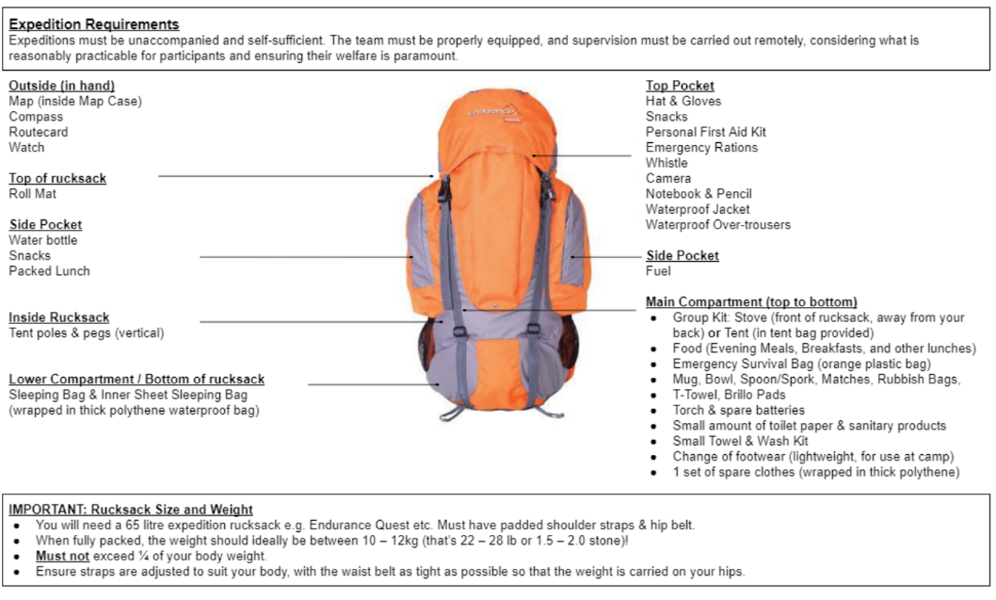
Rucksack packing
Notes:
Matt

Slide 18
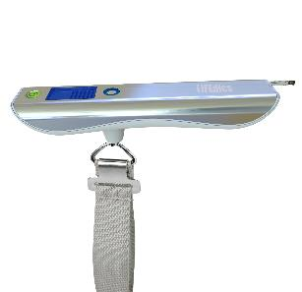
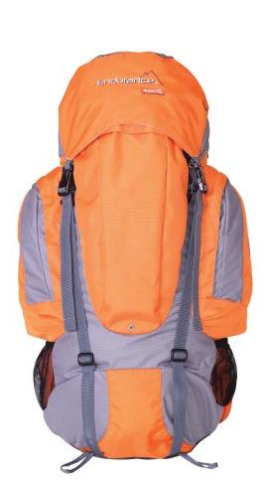
Avoid overpacking!
Personal = 9.5kg max
Food = 1.0kg
Group = 1.5kg
Total = 12.0kg
ALLOW SPACE FOR GROUP KIT
NO MORE THAN ¼ OF BODY WEIGHT
Notes:
Matt

Slide 19
Food
Lunch for first day
Sandwiches & snacks
Evening Meal (3 courses):
Cup-a-soup
Pasta / rice / Super Noodles
Cake & custard
Breakfast
Porridge, cereal, pancakes
Lunch for second day
Wraps & spread
Water (2L)
Emergency Rations
NO fresh meat, tins or glass
Notes:
Matt

Slide 20
Mobile Phone Policy
No mobile phone use except when approved by staff
For emergency use only
Switched off and sealed in a bag
Used to contact Supervisor
No access to social media, games or music
No direct home contact - via school staff if necessary
OS Locate App (free app)
Provides 6 figure grid reference
Download before attending
Notes:
Matt

Slide 21
Online Training: www.karosadventure.com
Notes:
Claire

Slide 22
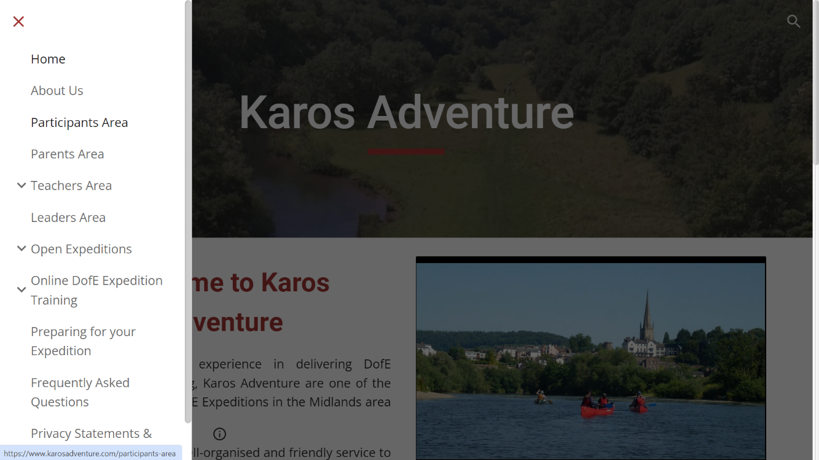
Online Training: www.karosadventure.com
Notes:
Claire

Slide 23
Online Training: www.karosadventure.com
Notes:
Claire

Slide 24
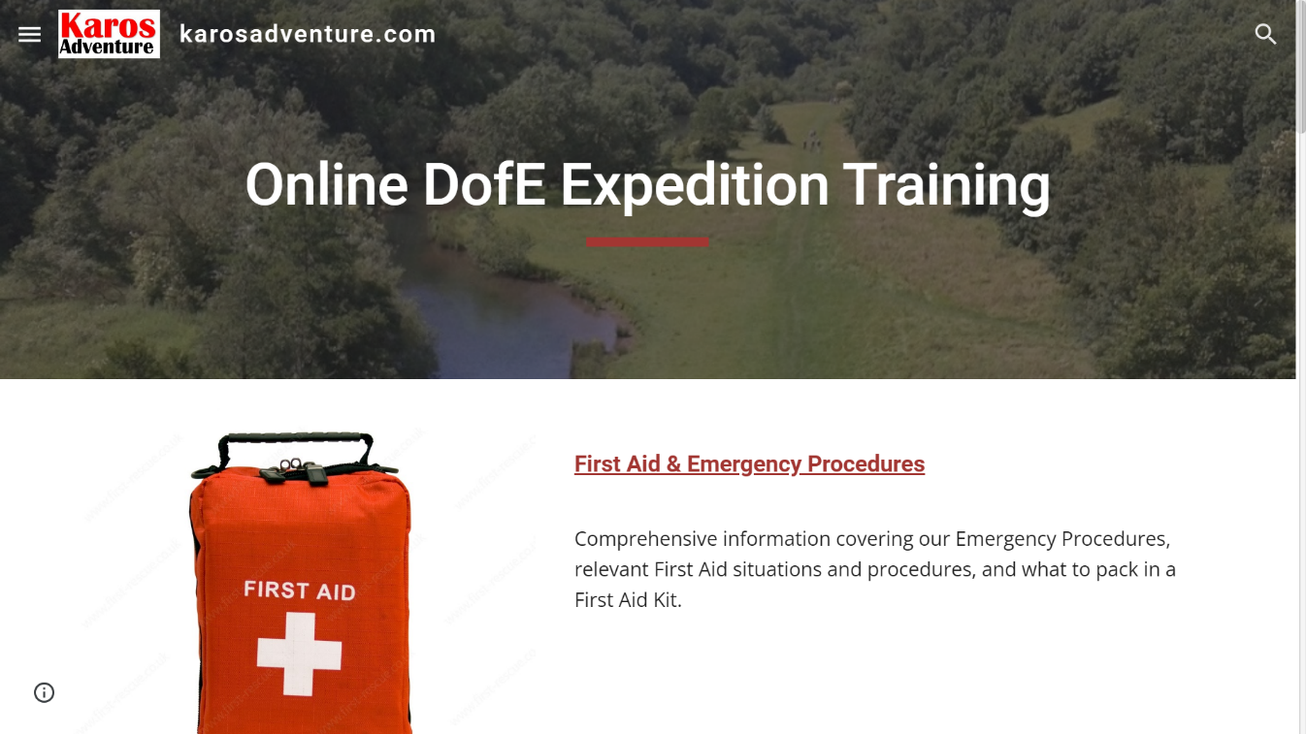
Online Training: www.karosadventure.com
Notes:
Claire

Slide 25
Online Training: www.karosadventure.com
Notes:
Claire

Slide 26
Sutton Coldfield Grammar School for Girls: Bronze
Residential Training
Sat 15th - Sun 16th June 2024
Beaumanor Hall Outdoor Centre, Leicestershire
9:30am - 3:30pm
Qualifying Expedition
Sat 29th - Sun 30th June 2024
Bradgate Park & surrounding area, Leicestershire
9:00am - 3:00pm
Notes:
Claire

Slide 27
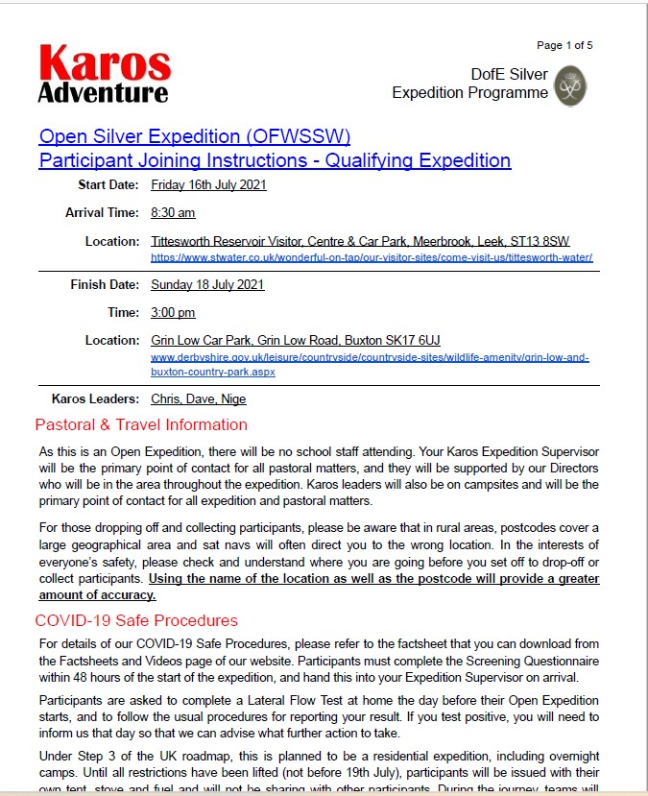
Joining Instructions
Issued 2-3 weeks before each activity
All you need to know for the activity
Details of dates, times, locations, equipment, contact details
Please read and keep information handy
Notes:
Claire

Slide 28
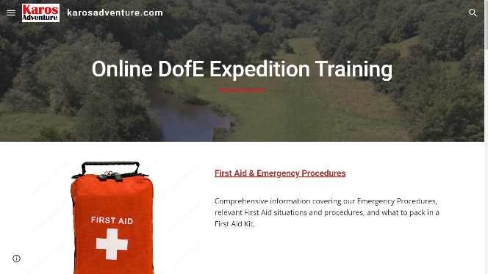
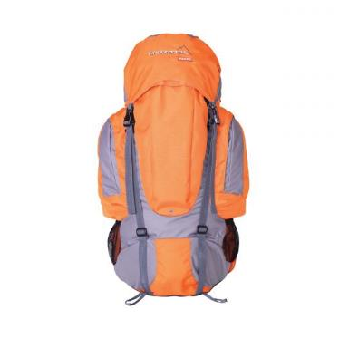
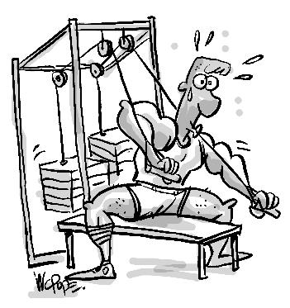
Summary - Getting Ready
Review our online training & videos
Prepare kit & food
Discuss & review any medical concerns
Prepare physically -
Be more active
Go for a walk
Break
Notes:
Claire

Slide 29
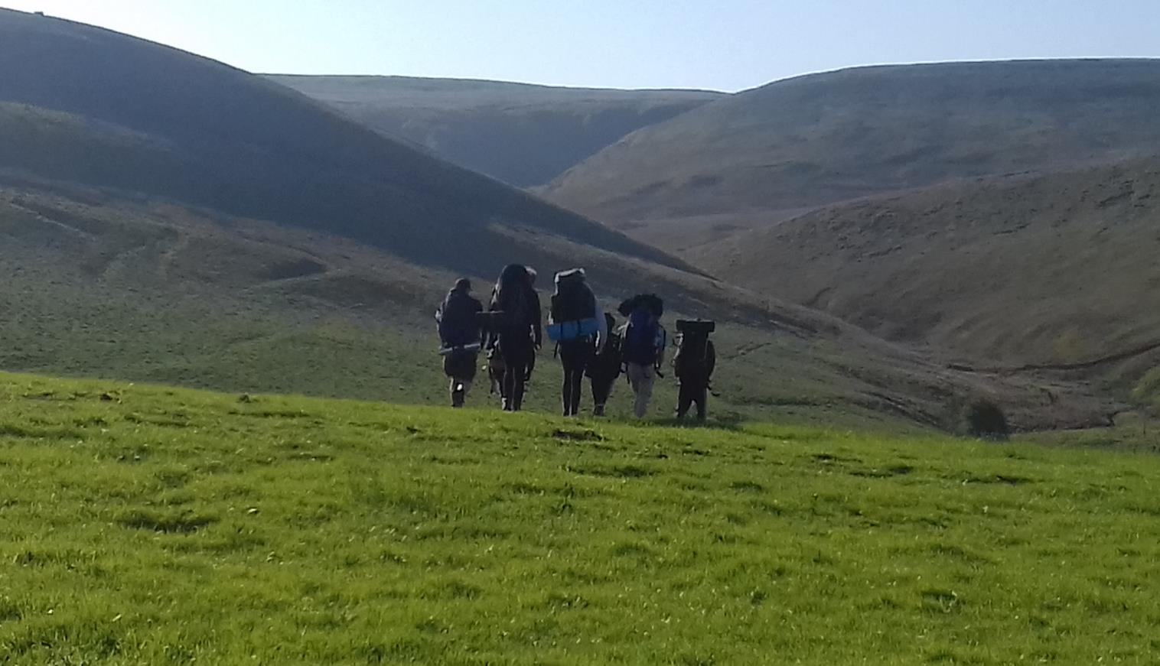
Good luck with your Award.
Thank you for listening. All questions welcome.
Contact Us
Mobile: 07498 869406
Web: www.karosadventure.com
Notes:
Claire

